Slide 1
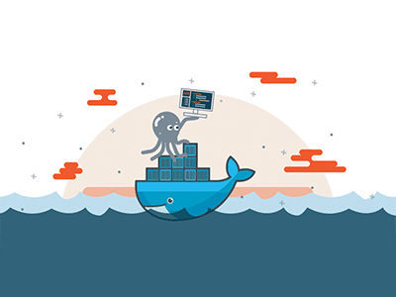

Introduction to docker

Slide 2
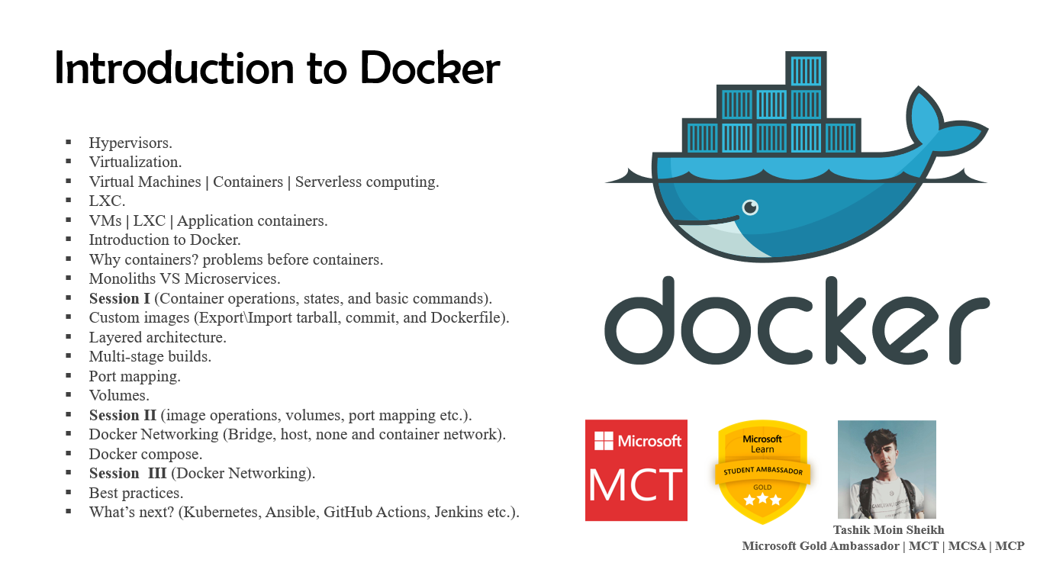

Slide 3
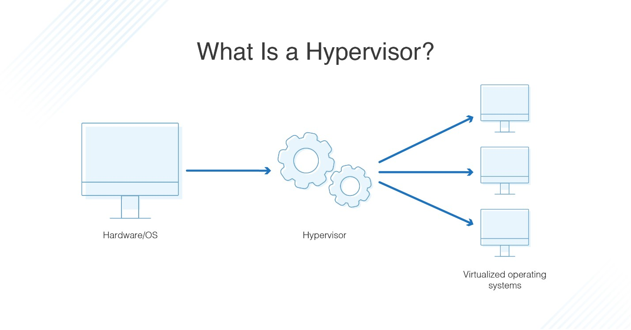

Hypervisor
A hypervisor, also known as a virtual machine monitor or VMM, is software that creates and runs virtual machines (VMs). A hypervisor allows one host computer to support multiple guest VMs by virtually sharing its resources, such as memory and processing.

Slide 4
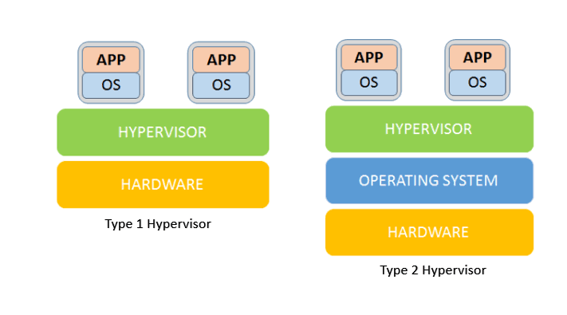
Bare metal (Type 1) vs hosted (type 2)
ESXi, Hyper-V, and Apple Boot Camp etc.
MSFT Virtual PC, Virtual Box, VMware Workstation etc.

Slide 5
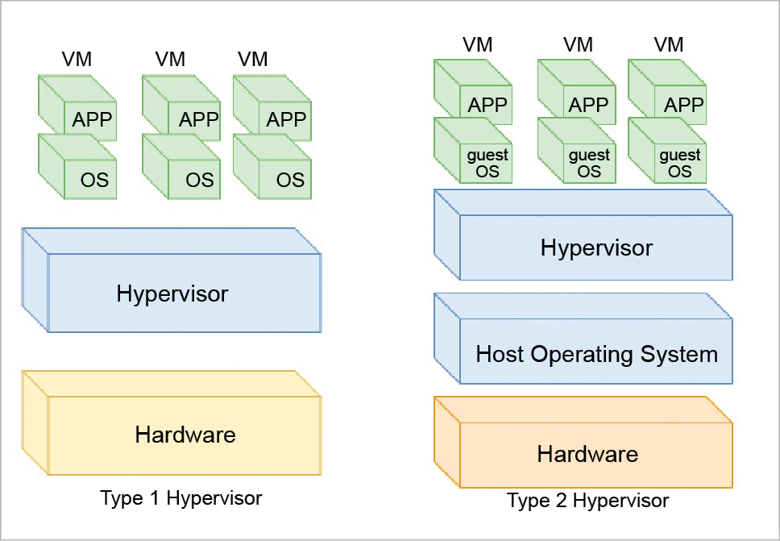
“OS” (No Host OS)
“Guest OS”

Slide 6
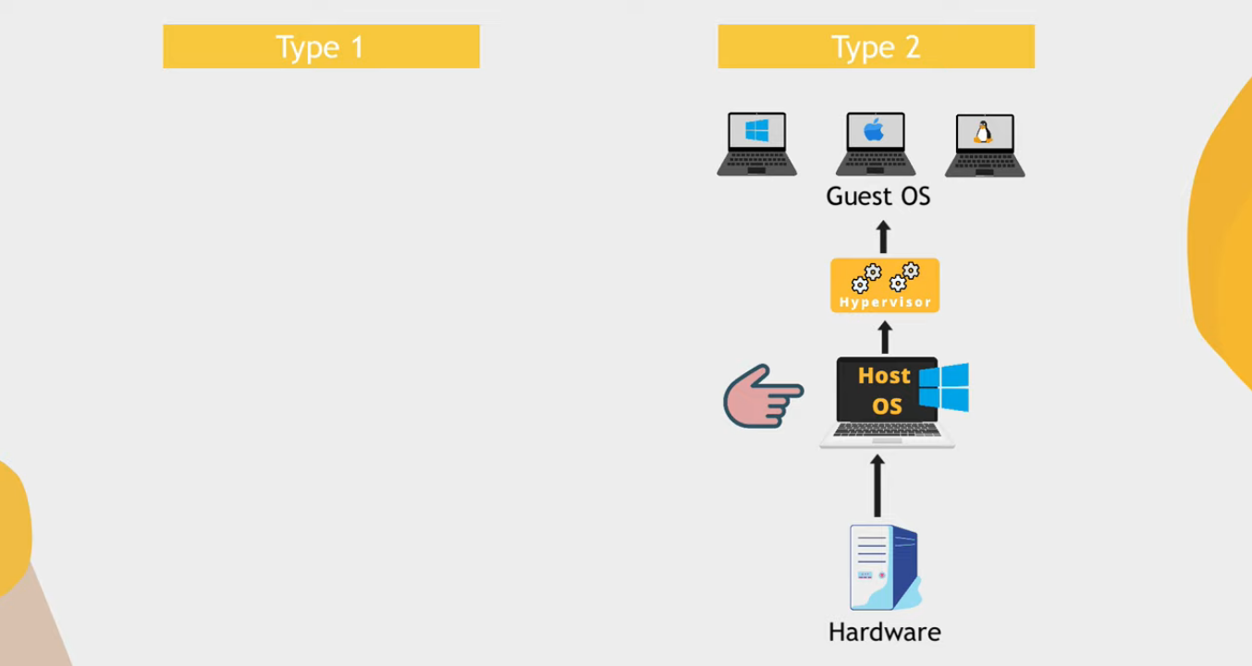

Slide 7
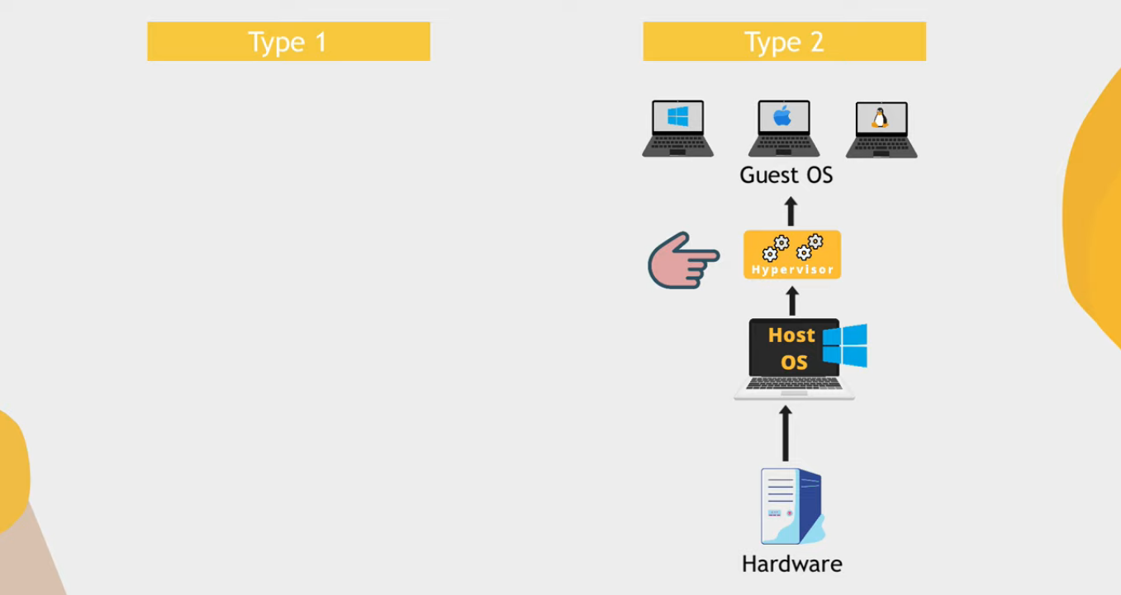

Slide 8
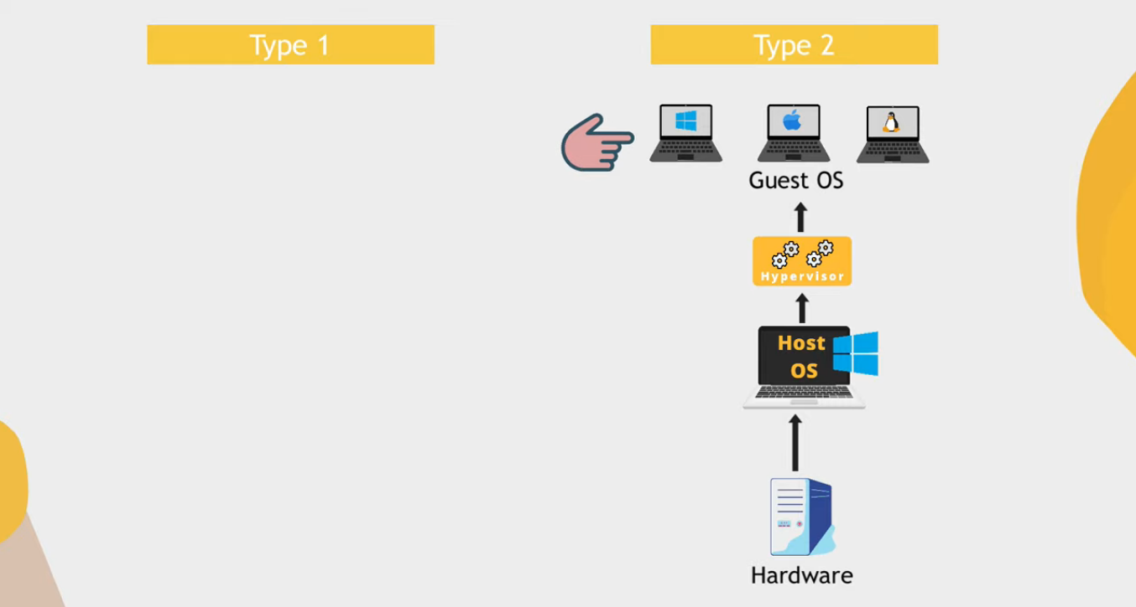

Slide 9
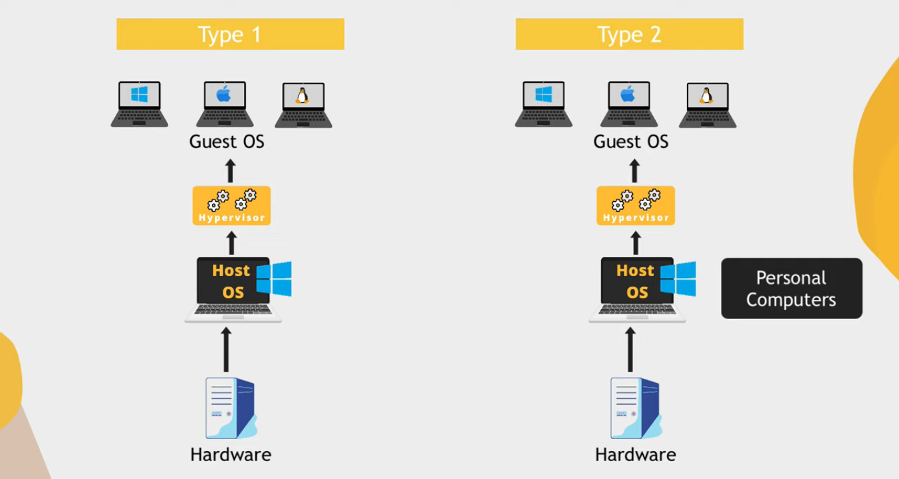
“Can only allocate host OS resources for virtualization”
“Same hardware resources”

Slide 10
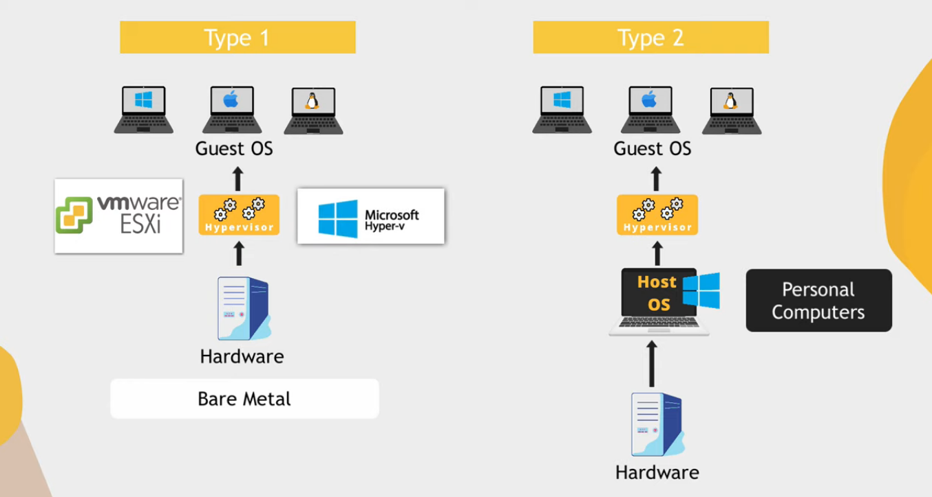

Slide 11
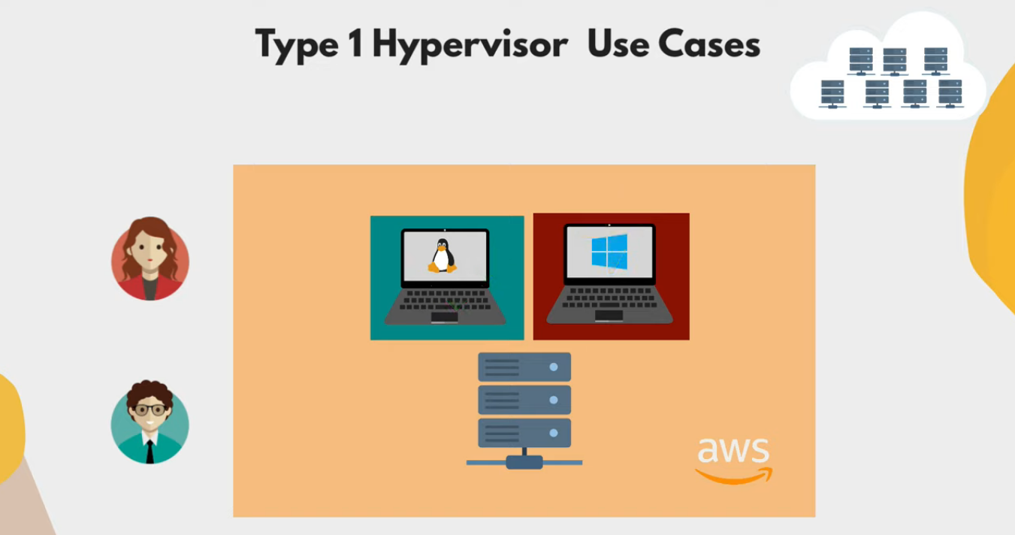

Slide 12
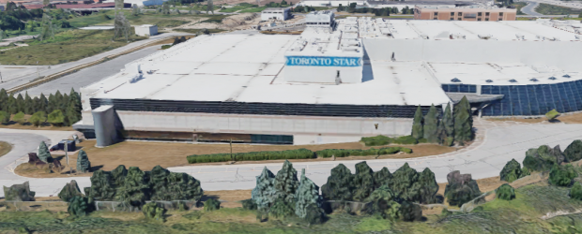
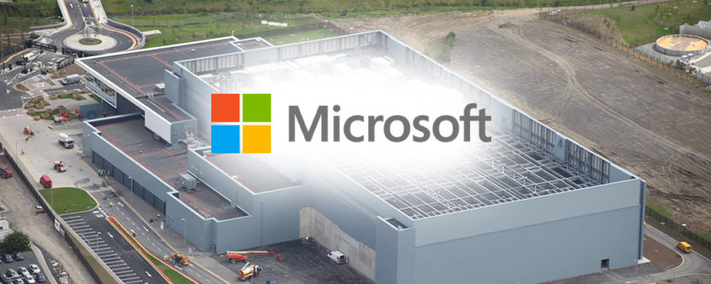
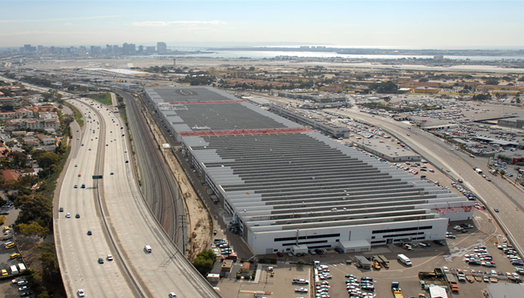
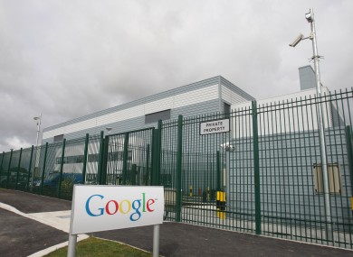
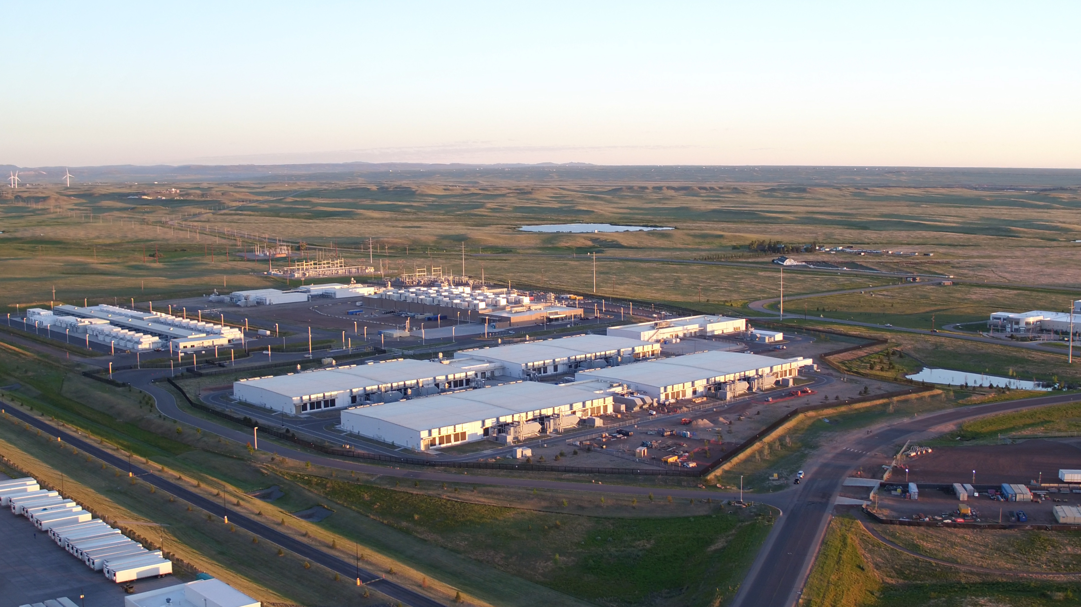
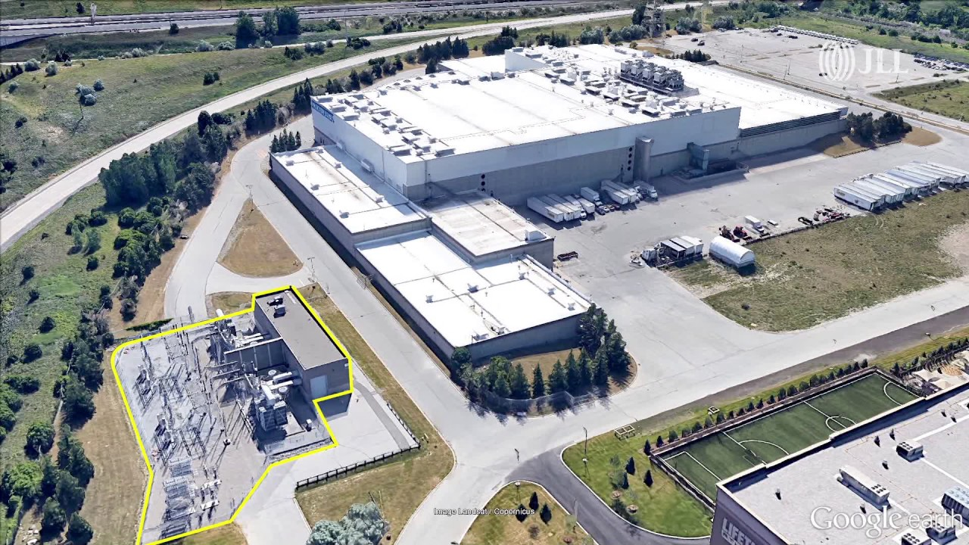

Slide 13
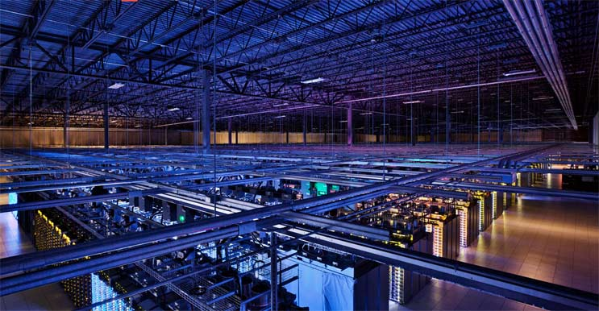
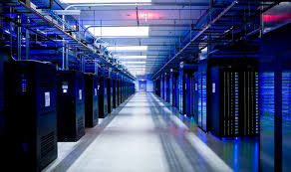
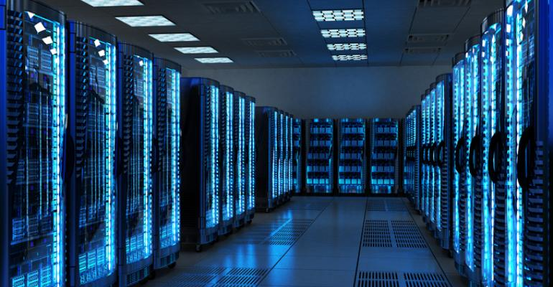
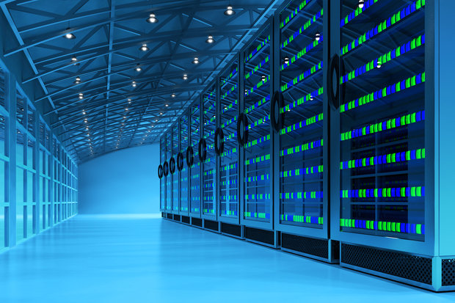

Slide 14
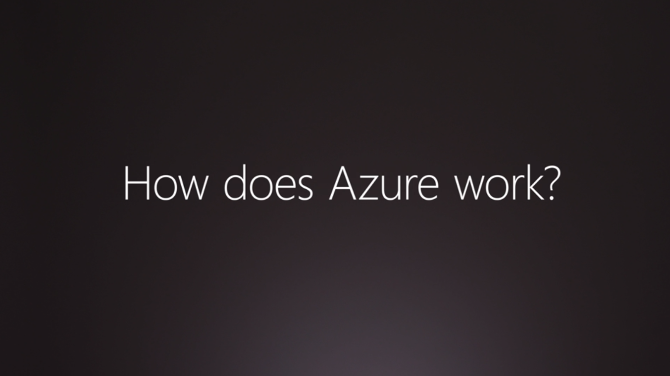

Slide 15
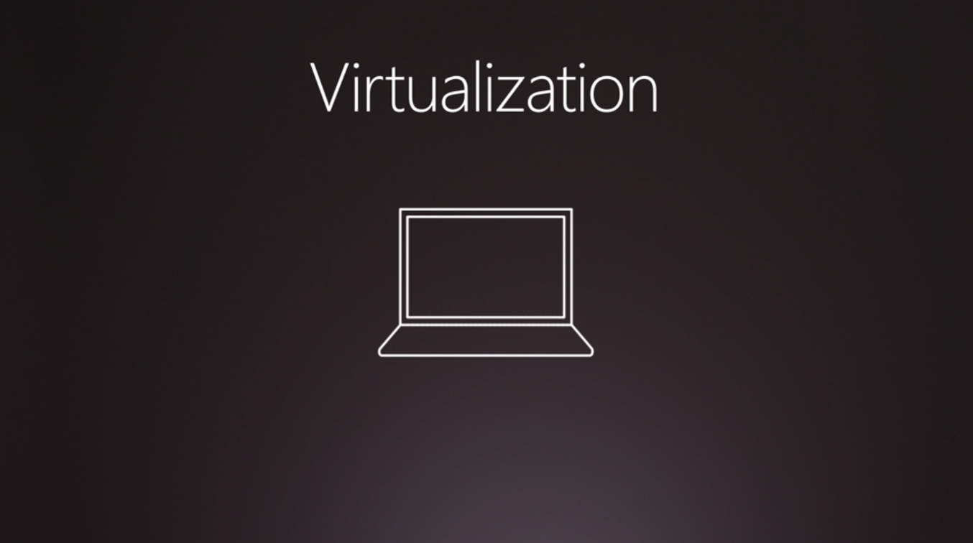

Slide 16
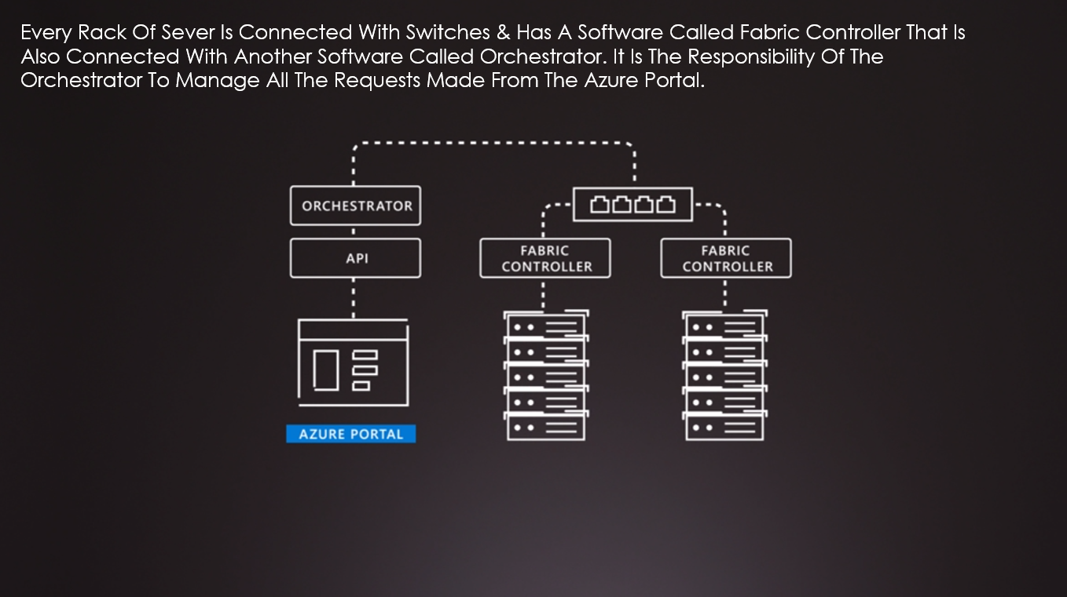

Slide 17
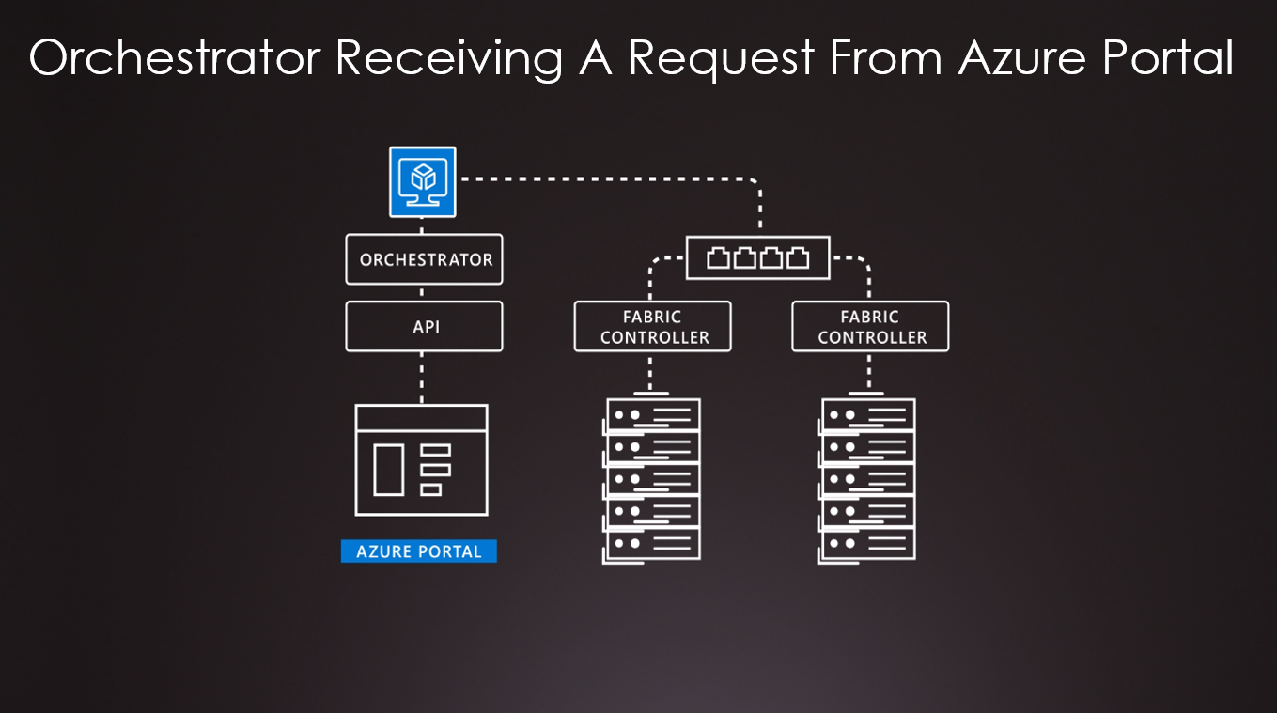

Slide 18
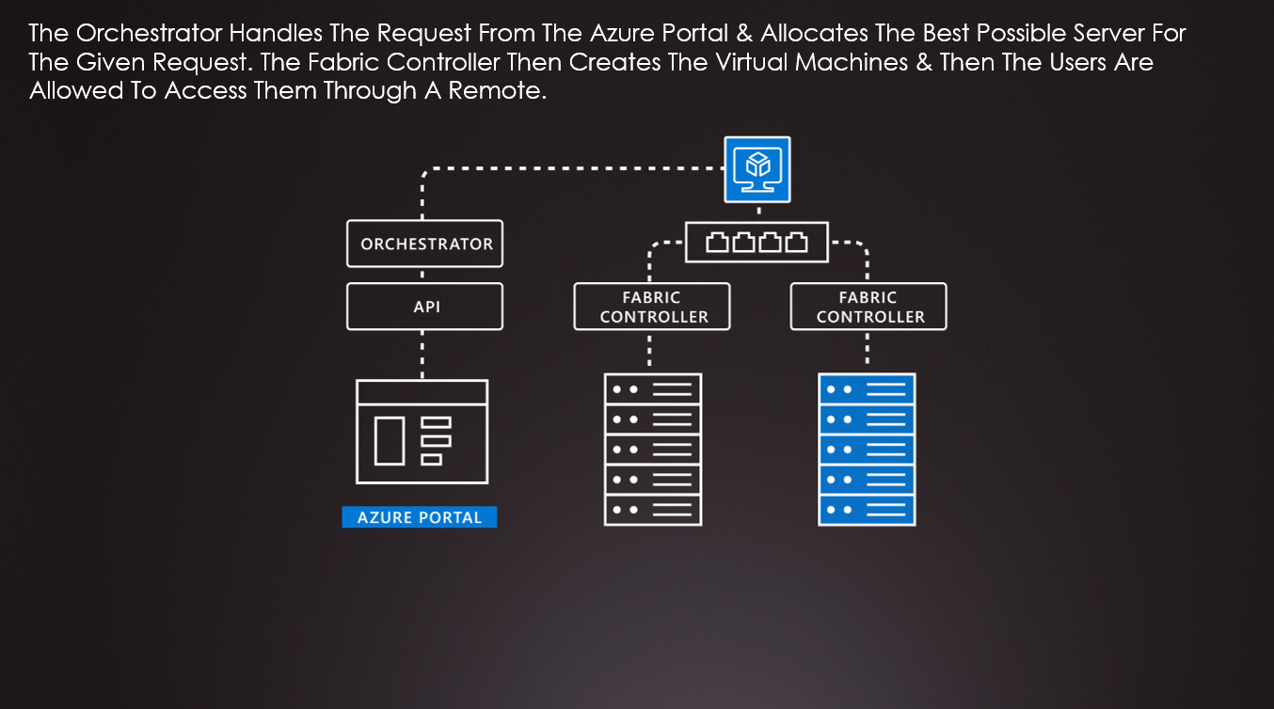

Slide 19
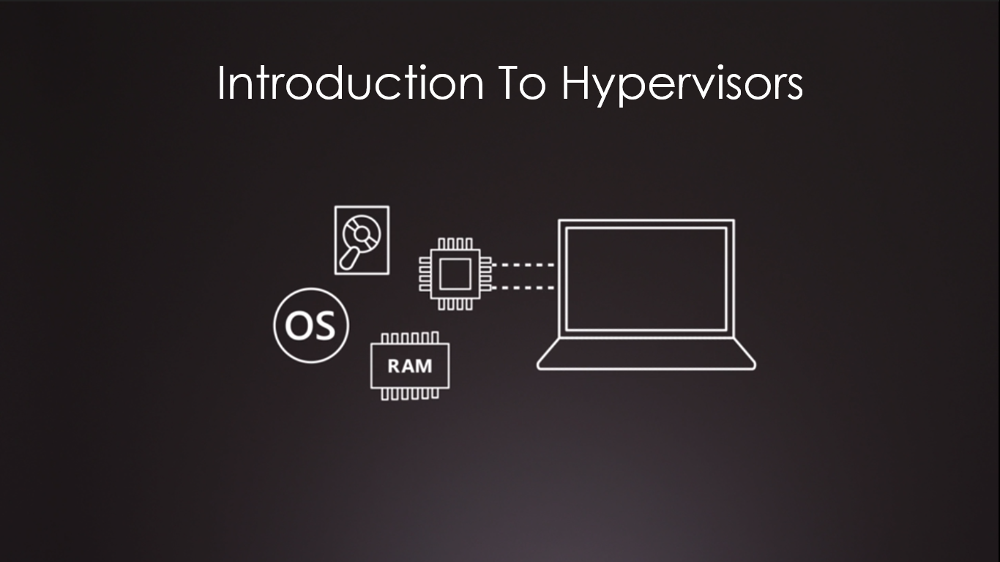

Slide 20
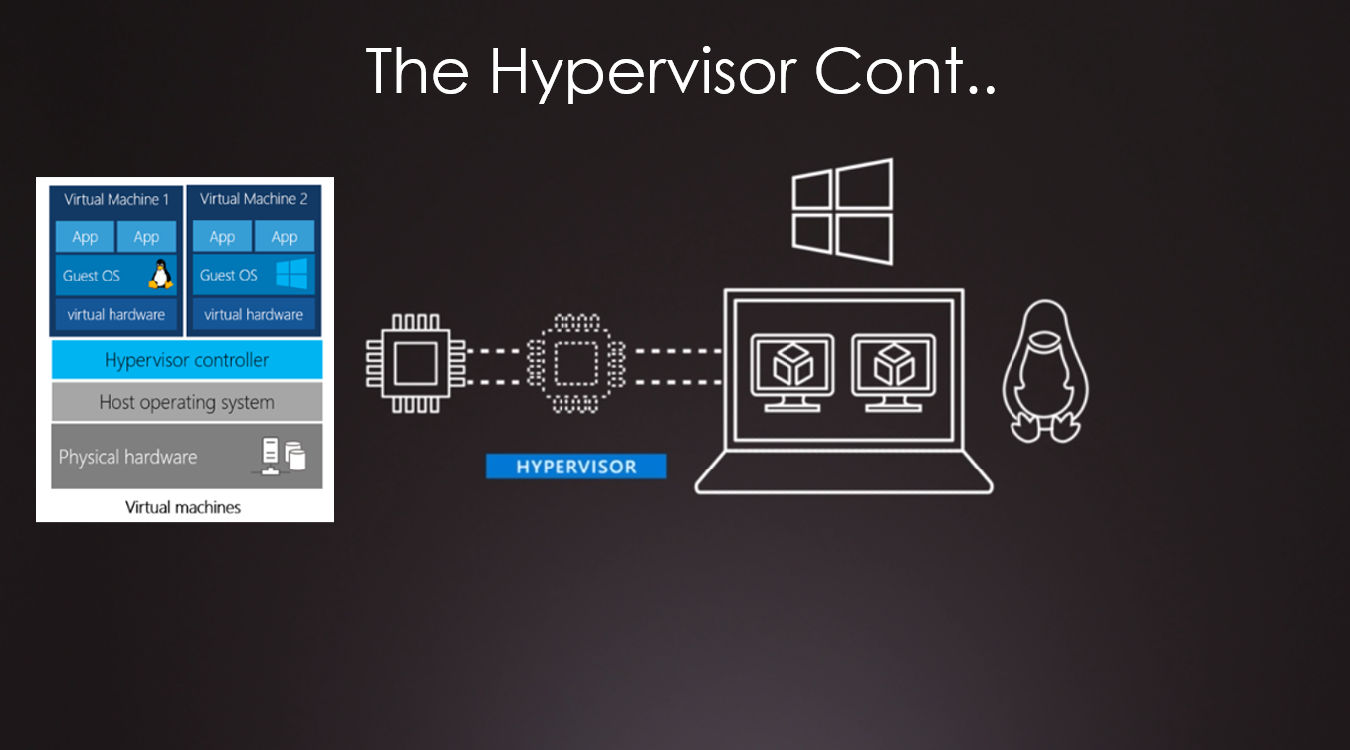

Slide 21
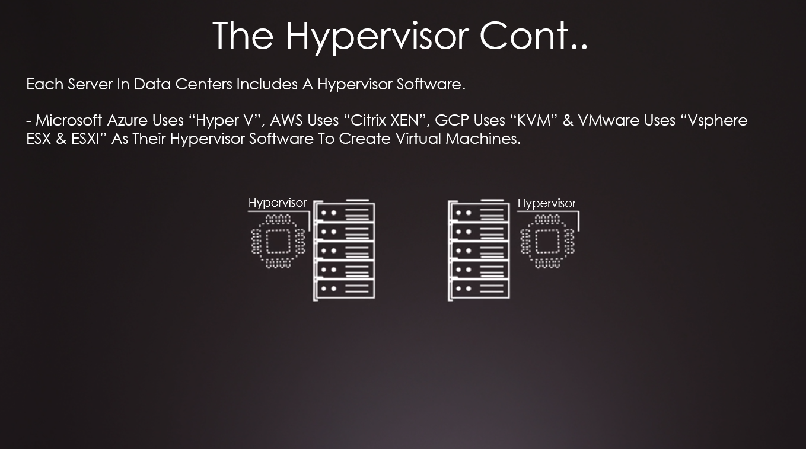

Slide 22
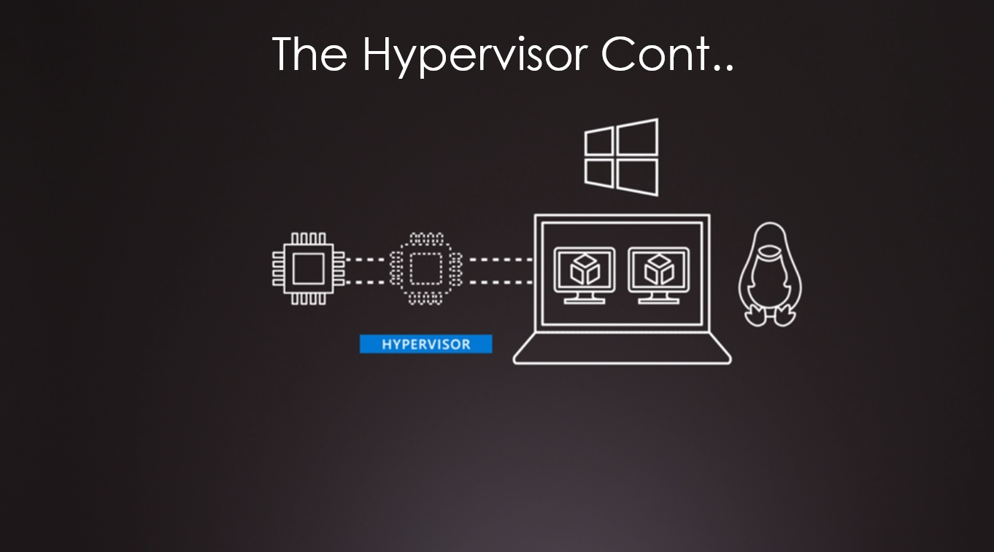

Slide 23
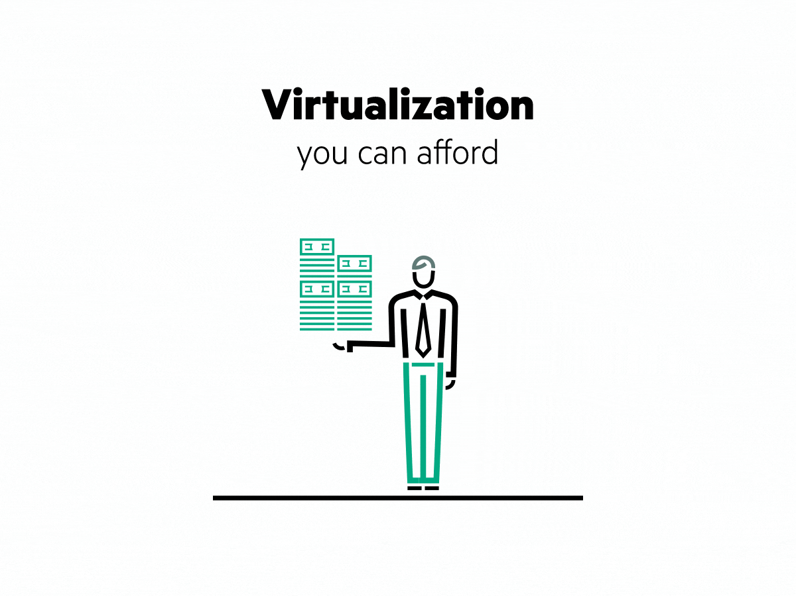
virtualization
Virtualization is the process of running a virtual instance of a computer system in a layer abstracted from the actual hardware. Most commonly, it refers to running multiple operating systems on a computer system simultaneously. Virtualization is the creation of a virtual -- rather than actual -- version of something, such as an operating system (OS), a server, a storage device or network resources. Virtualization uses software that simulates hardware functionality in order to create a virtual system Virtualization refers to the creation of a virtual resource such as a server, desktop, operating system, file, storage or network. The main goal of virtualization is to manage workloads by radically transforming traditional computing to make it more scalable.

Slide 24
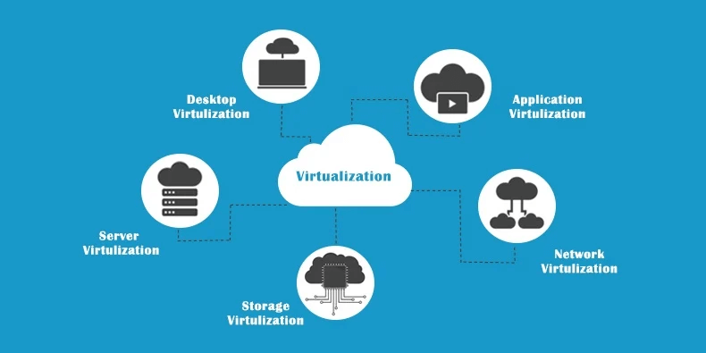

Slide 25
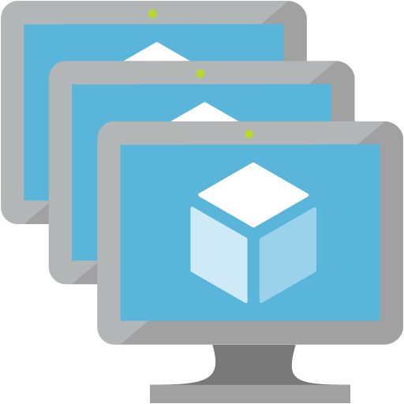
Virtual machines
Definition
Virtual machines are software computers that provide the same functionality as physical computers. Like physical computers, they run applications and an operating system. However, virtual machines are computer files that run on a physical computer and behave like a physical computer. In other words, virtual machines behave as separate computer systems.
Types Of Virtual Machines Process Virtual Machines Execute computer programs in a platform-independent environment. It masks the information of the underlying hardware or operating system. This allows the program to be executed in the same fashion on any platform. Example : JVM, .NET Core CLR etc.
System Virtual Machines
Support the sharing of a host computer’s physical resources between multiple virtual machines.
Example : Virtual Machines Created From VMware.

Slide 26
The JVM is called a virtual machine because the JVM definition defines an abstract machine. This includes registers, stack, etc., and the byte code that Java source is compiled to is practically machine code for this virtual machine. The JVM then interprets or compiles this byte code into native machine instructions.

Slide 27
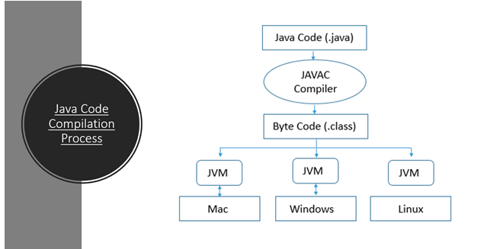

Slide 28
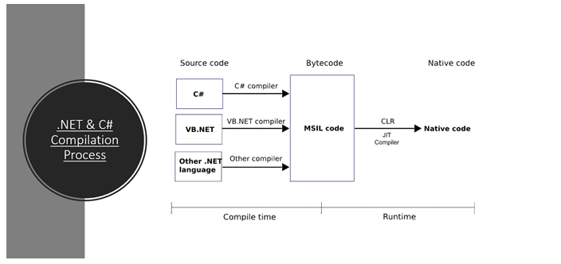

Slide 29
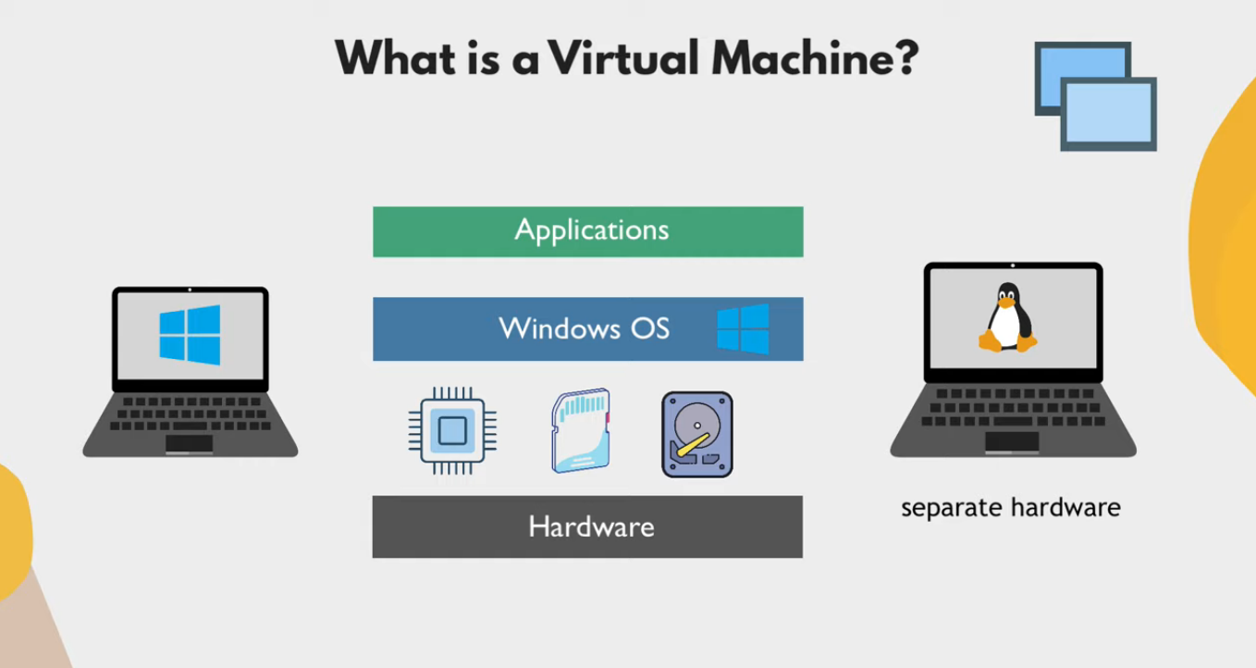

Slide 30
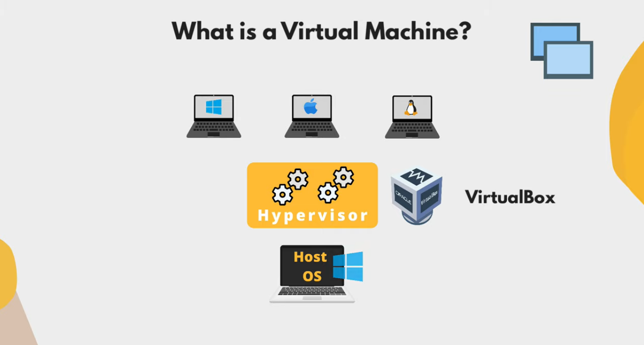

Slide 31
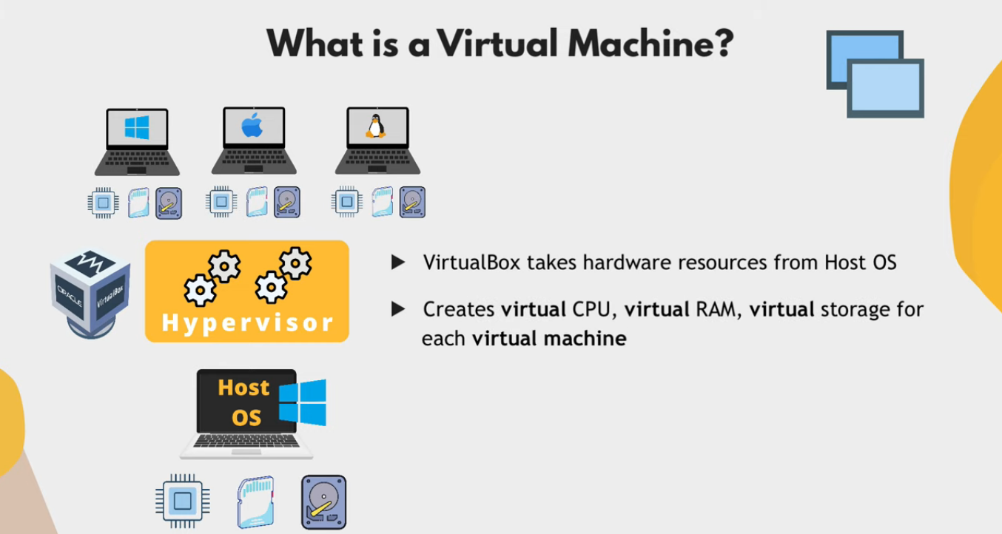

Slide 32
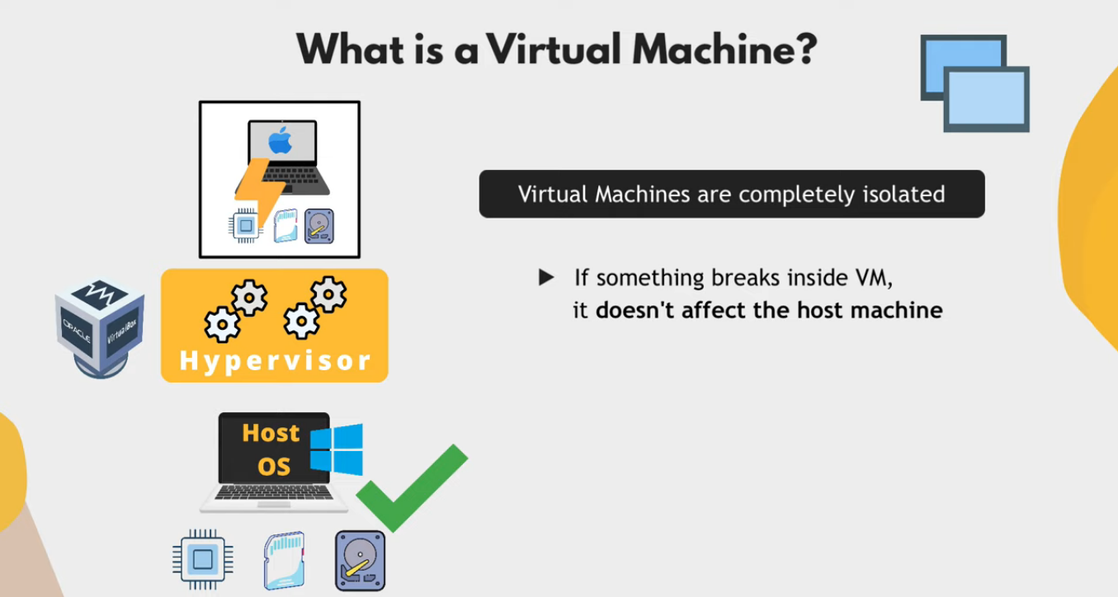

Slide 33
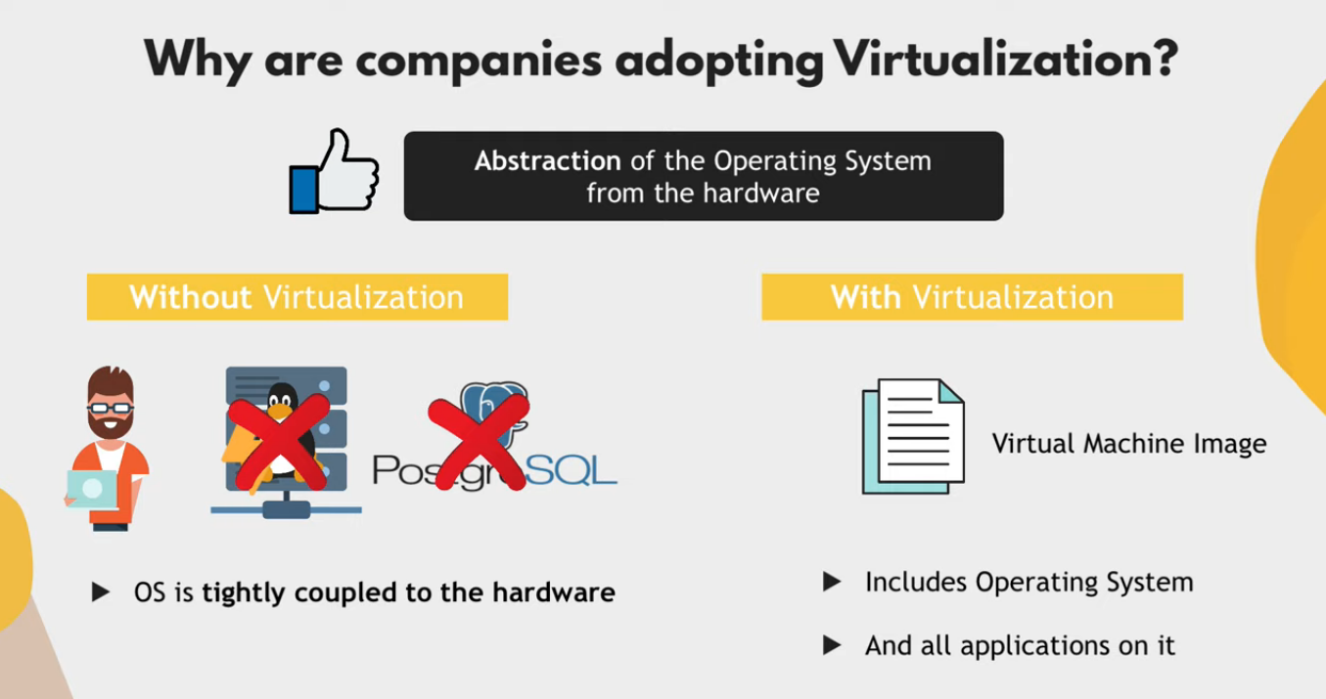

Slide 34
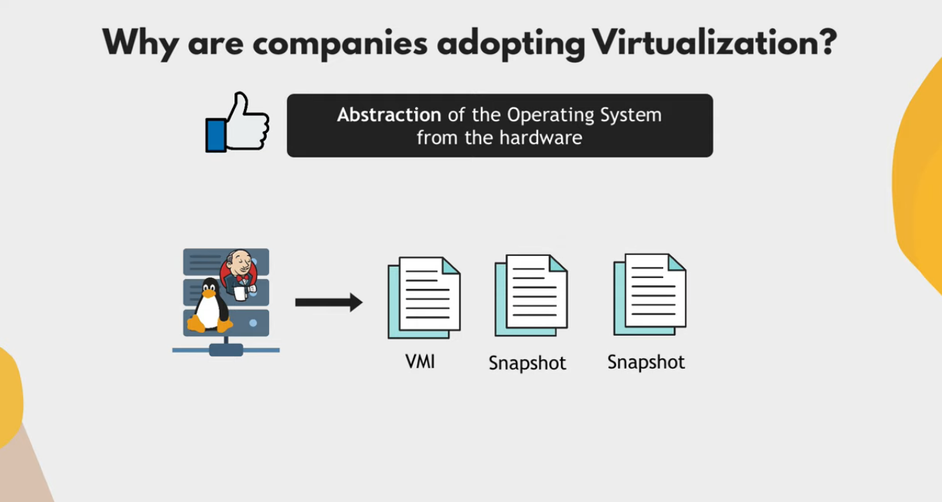

Slide 35
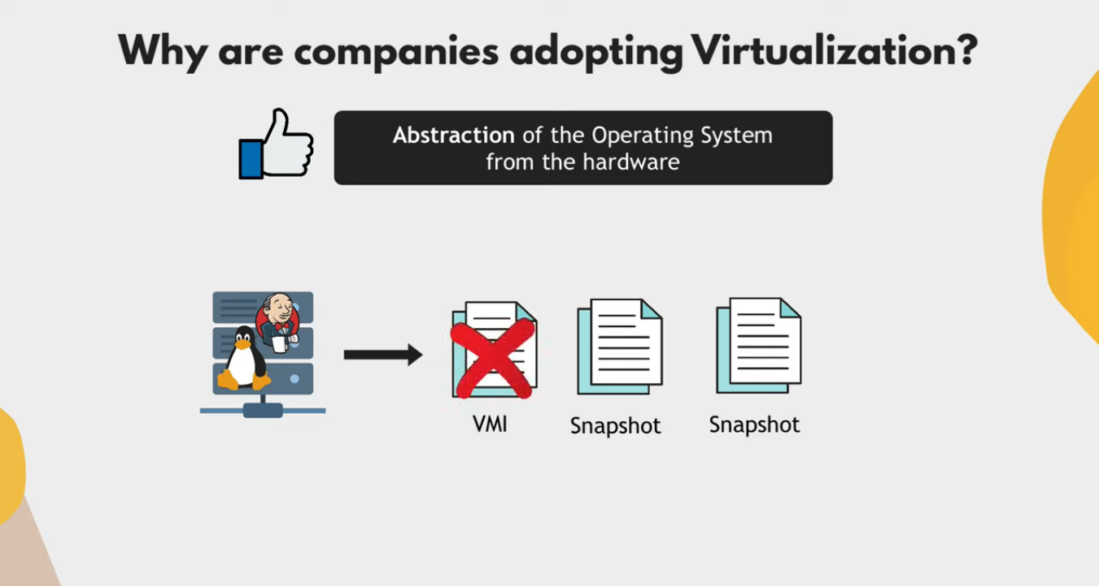
“Snapshot X”
Linux operating system represents everything in a file system, the hardware devices that we attach are also represented as a file. The terminal is also represented as a file.
“Time 0”
“Time 1”
“Time N”

Slide 36
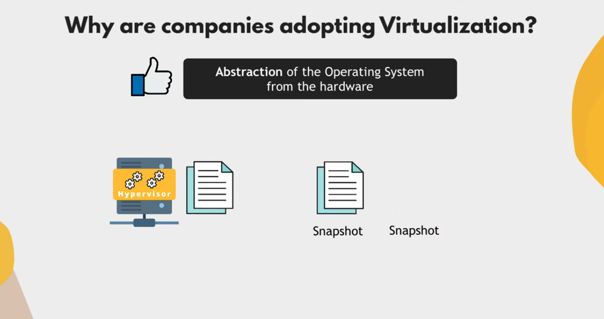

Slide 37
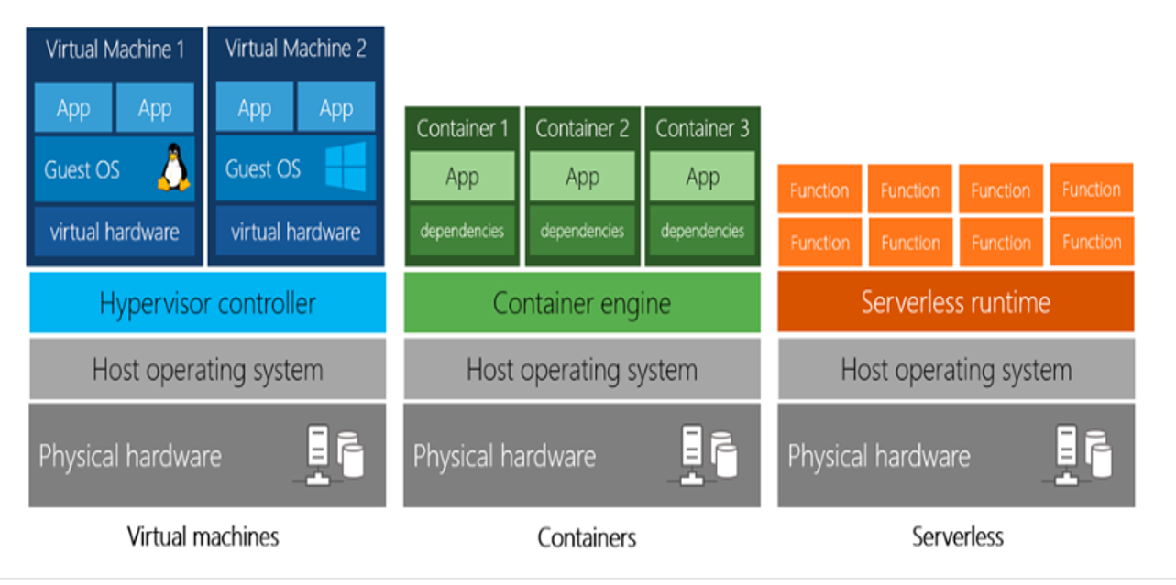
Virtual machines vs containers VS serverless

Slide 38
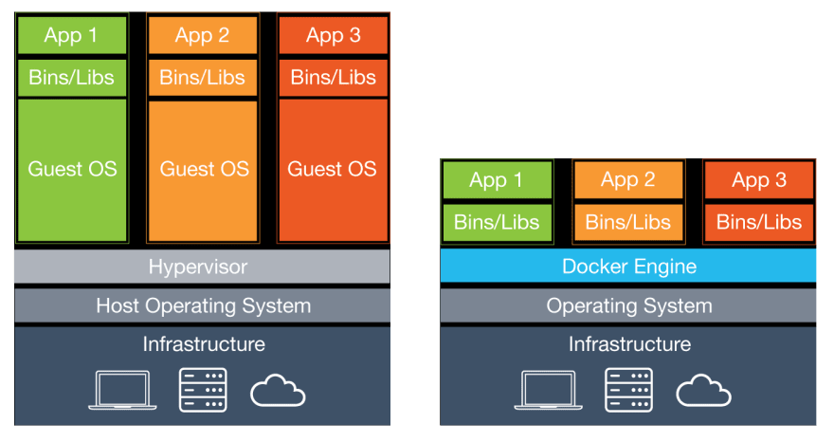
Virtual machines vs containers

Slide 39
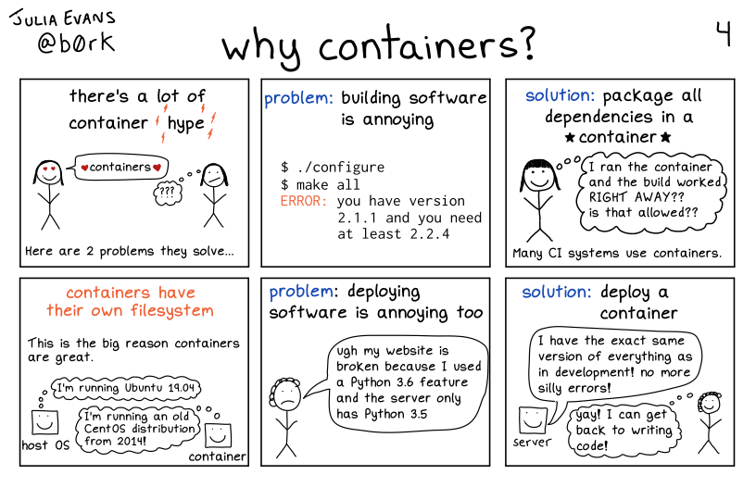

Slide 40
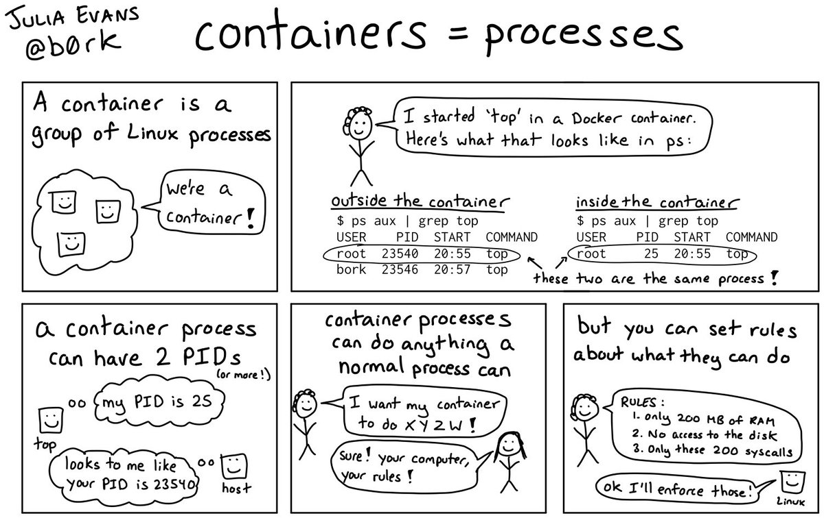

Slide 41
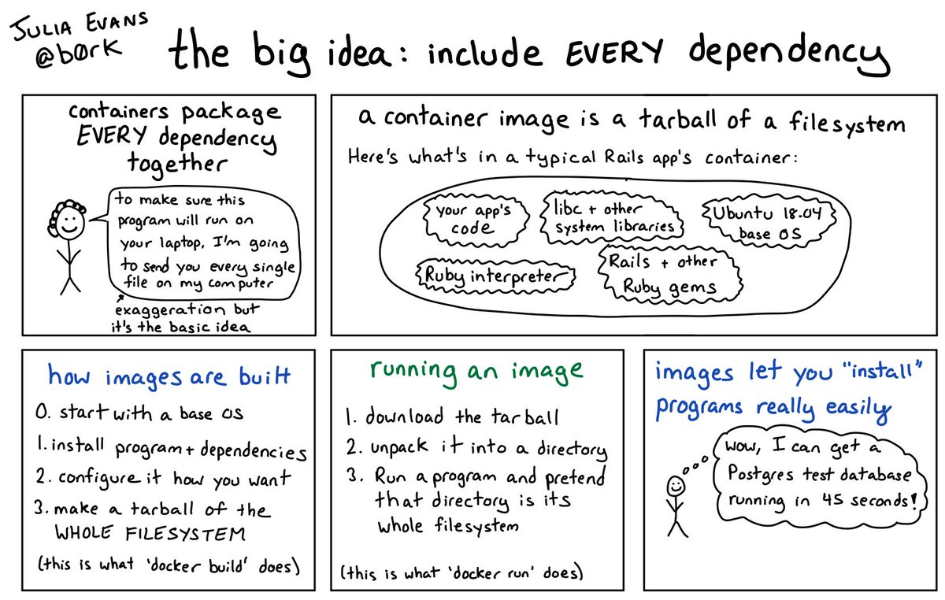

Slide 42
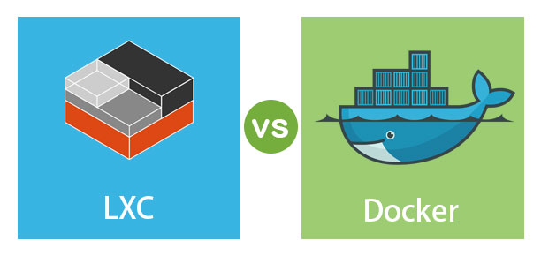

Slide 43
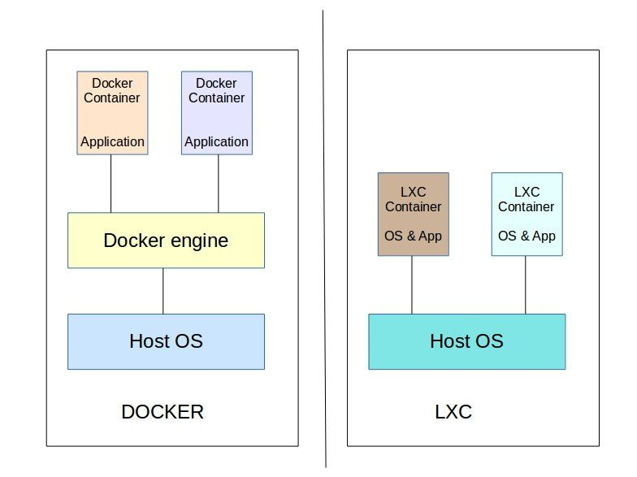
Linux containers (Lxc)
LXC is a user space interface for the Linux kernel containment features. Through a powerful API(LXD) and simple tools, it lets Linux users easily create and manage system or application containers. LXC containers are often considered as something in the middle between a chroot and a full fledged virtual machine. The goal of LXC is to create an environment as close as possible to a standard Linux installation but without the need for a separate kernel. Reference: https://linuxcontainers.org/lxc/introduction/

Slide 44

Containers uses the same host machine’s kernel instead of using a separate kernel but they have separate file systems.

Slide 45


Slide 46


Slide 47


Slide 48


Slide 49
Virtual Machines - Heavy
- Fixed memory, and CPU cores for each GuestOS (Non-sharable). LXC using LXD REST API Interface
- Lightweight than VMs.
- Uses LXD API to make LXC containers. - Each GuestOS can use entire hardware resources together (Memory, and CPU cores).
- We can also limit memory, and CPU core just like VMs.
- Nested LXC containers are possible.
- Each GuestOS uses the same host OS Kernel.
- LXC containers are used for running multiple applications in an isolated environment.
- More Fast than VMs. - How to make an LXC? https://www.youtube.com/watch?v=CWmkSj_B-wo - More on LXC, https://www.upguard.com/blog/docker-vs-lxc Application Containers
- More lightweight than LXC.
- Uses same host machine kernel.
- Docker containers(Application containers) are made for running single application per container.
- No need to worry about RAM, Space, CPU and other resource allocations for contaienrs.
- Fast than LXC.

Slide 50


Slide 52


docker
Docker is a set of platform as a service products that use OS-level virtualization to deliver software in packages called containers. Containers are isolated from one another and bundle their own software, libraries and configuration files; they can communicate with each other through well-defined channels. – Wikipedia.

Slide 53


Slide 54
Working of Docker
docker → docker daemon → containerd → runC → unshare syscall

Slide 55


Slide 56


Slide 57


Slide 58


Slide 59


Slide 60

← Shows status of docker engine.

Slide 61

← Shows status of docker engine.

Slide 62

← Gives information about containers, version, driver, filesystem etc.

Slide 63

← Lists total images available at host machine.

Slide 64

← Removes all the “exited/stopped” containers.

Slide 65


← Removes all the images.

Slide 66

← Stops the running container.

Slide 67

← Removes container having any id/name __.

Slide 68


Slide 69



Slide 70


Slide 71



Slide 72


Slide 73


Slide 74


Slide 75


Slide 76


Slide 77

It is not an IP address of Host Machine.

Slide 78

To check host machine’s IP address.

Slide 79

host machine’s IP address.

Slide 80


Slide 81

First_webserver container’s IP address.

Slide 82


Slide 83

Second_webserver container’s IP address.

Slide 84


Slide 85

Host’s port 80 was not mapped with first_webserver container.

Slide 86

Host’s port 100 was mapped with second_webserver container.

Slide 87

To attach your terminal's standard input, output, and error (or any combination of the three) to a running container using the container's ID or name. This allows you to view its ongoing output or to control it interactively, as though the commands were running directly in your terminal.

Slide 88


Slide 89


Slide 90


Slide 91


Slide 92


Slide 93
Image creation

Slide 94


Slide 95


Slide 96


Slide 97
VOLUME MAPPING

Slide 98
To make the container's memory persistent, we do volume mapping.
- If the container is restarted/deleted to upgrade versions of the current application, the memory will not be lost.
- Each container makes a new volume when it is created, these newly created volumes that are created at the time of the container's creation can be seen inside the host machine’s → 'var/lib/docker/volumes' directory. These volumes have a random 40 digit hashed name if the name is not given to the volume at the time of container creation.

Slide 99


Slide 100


Slide 101


Slide 102


Slide 103

Creating containers from already existing volumes.

Slide 104


Slide 105

Removing all the useless volumes that are not associated with any container (prune).

Slide 106

file/folder volume mapping.

Slide 107


Slide 108


Slide 109

All the changes are reflected inside container immediately.

Slide 110


Slide 111
DOCKERFILE

Slide 112
docker-compose file versions https://docs.docker.com/compose/compose-file/

Slide 113


Slide 114


Slide 115


Slide 116


Slide 117


Slide 118


Slide 119
Shell form<instruction> <command>
Examples,
RUN apt-get install python3
CMD echo "Hello world“
ENTRYPOINT echo "Hello world“
When instruction is executed in shell form it calls /bin/sh -c <command> under the hood and normal shell processing happens. For example, the following snippet in Dockerfile.

Slide 120
Exec form
This is the preferred form for CMD and ENTRYPOINT instructions.<instruction> ["executable", "param1", "param2", ...] RUN has two forms, RUN <command> (shell form) RUN ["executable", "param1", "param2"] (exec form) CMD has three forms, CMD ["executable","param1","param2"] (exec form, preferred) CMD ["param1","param2"] (sets additional default parameters for ENTRYPOINT in exec form) CMD command param1 param2 (shell form) The second one is used together with ENTRYPOINT instruction in exec form. It sets default parameters that will be added after ENTRYPOINT parameters if the container runs without command line arguments. for example. ENTRYPOINT ["/bin/echo", "Hello"] CMD ["world"]

Slide 121
ENTRYPOINT has two forms,
ENTRYPOINT ["executable", "param1", "param2"] (exec form, preferred)
ENTRYPOINT command param1 param2 (shell form)

Slide 122


Slide 123
Best Practices

Slide 124


Slide 125


Slide 126


Slide 127


Slide 128


Slide 129


Slide 130


Slide 131


Slide 132
MULTI-STAGE BUILDS

Slide 133


Slide 134
FROM alpine as first
WORKDIR /multi-stage
COPY abc.cpp /multi-stage
WORKDIR /multi-stage
RUN apk update && apk add g++ && g++ abc.cpp -o abc ENV LANG en_US.UTF-8
FROM alpine as second
RUN apk add libstdc++
COPY --from=first /multi-stage /multi-stage

Slide 135


Slide 136


Slide 137


Slide 138

During multi-stage builds, docker creates and destroy the containers.

Slide 139

final and untagged images of multi-stage builds
huge difference in sizes.

Slide 140

“final output”

Slide 141
Docker Networking

Slide 142


Slide 143


Slide 144


Slide 145


Slide 146


Slide 147


Slide 148


Slide 149


Slide 150


Slide 151


Slide 152


Slide 153


Slide 154


Slide 155


Slide 156
No Name Resolution With Default Bridge Network (Docker0)

Slide 157


Slide 158


Slide 159


Slide 160


Slide 161


Slide 162


Slide 163
Name Resolution With User Defined Network

Slide 164


Slide 165


Slide 166


Slide 167


Slide 168


Slide 169


Slide 170


Slide 171


Slide 172


Slide 173


Slide 174


Slide 175


